Slide 1
Secondary operations
PM secondary operations include densification, sizing, impregnation, infiltration, heat treatment, and finishing. Densification and Sizing a number of secondary operations are performed to increase density, improve accuracy, or accomplish additional shaping of the sintered part.
Densification (repressing) is a pressing operation in which the part is squeezed in a closed die to increase density and improve physical properties.
Sizing is the pressing of a sintered part to improve dimensional accuracy.

Slide 2
Coining is a press working operation on a sintered part to press details into its surface. Some PM parts require machining after sintering.
Machining is rarely done to size the part, but rather to create geometric features that cannot be achieved by pressing, such as internal and external threads, side holes, and other details.
Impregnation and Infiltration
Porosity is a unique and inherent characteristic of powder metallurgy technology. It can be exploited to create special products by filling the available pore space with oils, polymers, or metals that have lower melting temperatures than the base powder metal.

Slide 3
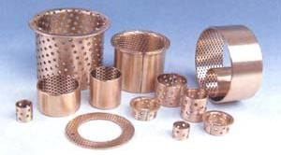
Figure(1): Examples of commercially manufactured self-lubricating bearings.

Slide 4
Impregnation is the term used when oil or other fluid is permeated into the pores of a sintered PM part. The most common products of this process are oil-impregnated bearings, gears, and similar machinery components.
Self-lubricating bearings, usually made of bronze or iron with 10% to 30% oil by volume, are widely used in the automotive industry.
The treatment is accomplished by immersing the sintered parts in a bath of hot oil.
An alternative application of impregnation involves PM parts that must be made pressure tight or impervious to fluids.

Slide 5
In this case, the parts are impregnated with various types of polymer resins that seep into the pore spaces in liquid form and then solidify.
In some cases, resin impregnation is used to facilitate subsequent processing, for example, to permit the use of processing solutions (such as plating chemicals) that would otherwise soak into the pores and degrade the product, or to improve machinability of the PM work part.

Slide 6
Infiltration is an operation in which the pores of the PM part are filled with a molten metal. The melting point of the filler metal must be below that of the PM part. The process involves heating the filler metal in contact with the sintered component so that capillary action draws the filler into the pores.
The resulting structure is relatively nonporous, and the infiltrated part has a more uniform density, as well as improved toughness and strength.
An application of the process is copper infiltration of iron PM parts.

Slide 7
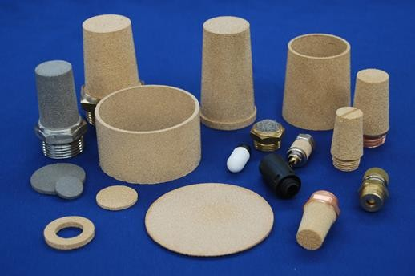
Figure (2):Various types of metal filters

Slide 8
Heat treatment and finishing
Powder metal components can be heat treated and finished (electroplated or painted) by most of the same processes used on parts produced by casting and other metal working processes.
Special care must be exercised in heat treatment because of porosity; for example, salt baths are not used for heating PM parts.
Plating and coating operations are applied to sintered parts for appearance purposes and corrosion resistance.
Again, precautions must be taken to avoid entrapment of chemical solutions in the pores; impregnation and infiltration are frequently used for this purpose.
Common platings for PM parts include copper, nickel, chromium, zinc, and cadmium.

